Slide 1
Validation: To cache, or not to cache, …
April 17, 2014
Dana Harrington
Validation & Caching
Scala Meet-up

Slide 2
A Story of Three Parts…
Tracking partial failure in composite data to avoid caching bad data.
Build your own monads.
Moggi’s Notions of Computation and Monads (1991):
Thinking about domain specific computational models.
Validation & Caching
Scala Meet-up, April 2014

Slide 3
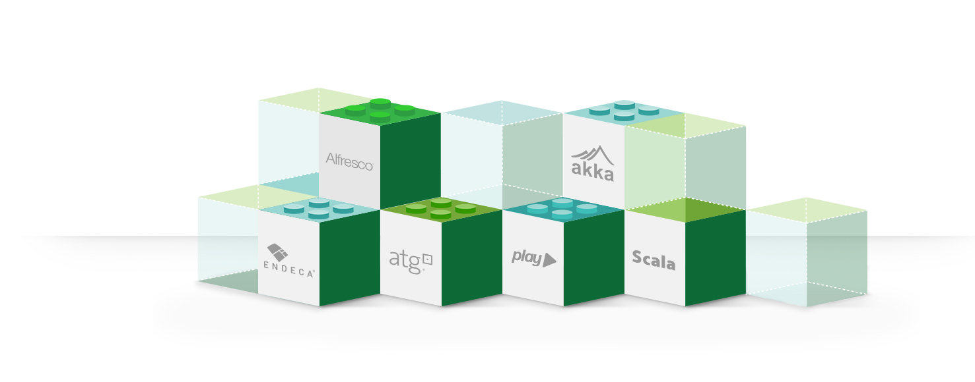
The Protagonist: Walmart.ca
Fully responsive UI
Fully reactive (asynchronous, non-blocking) backend
Validation & Caching
Scala Meet-up, April 2014

Slide 4
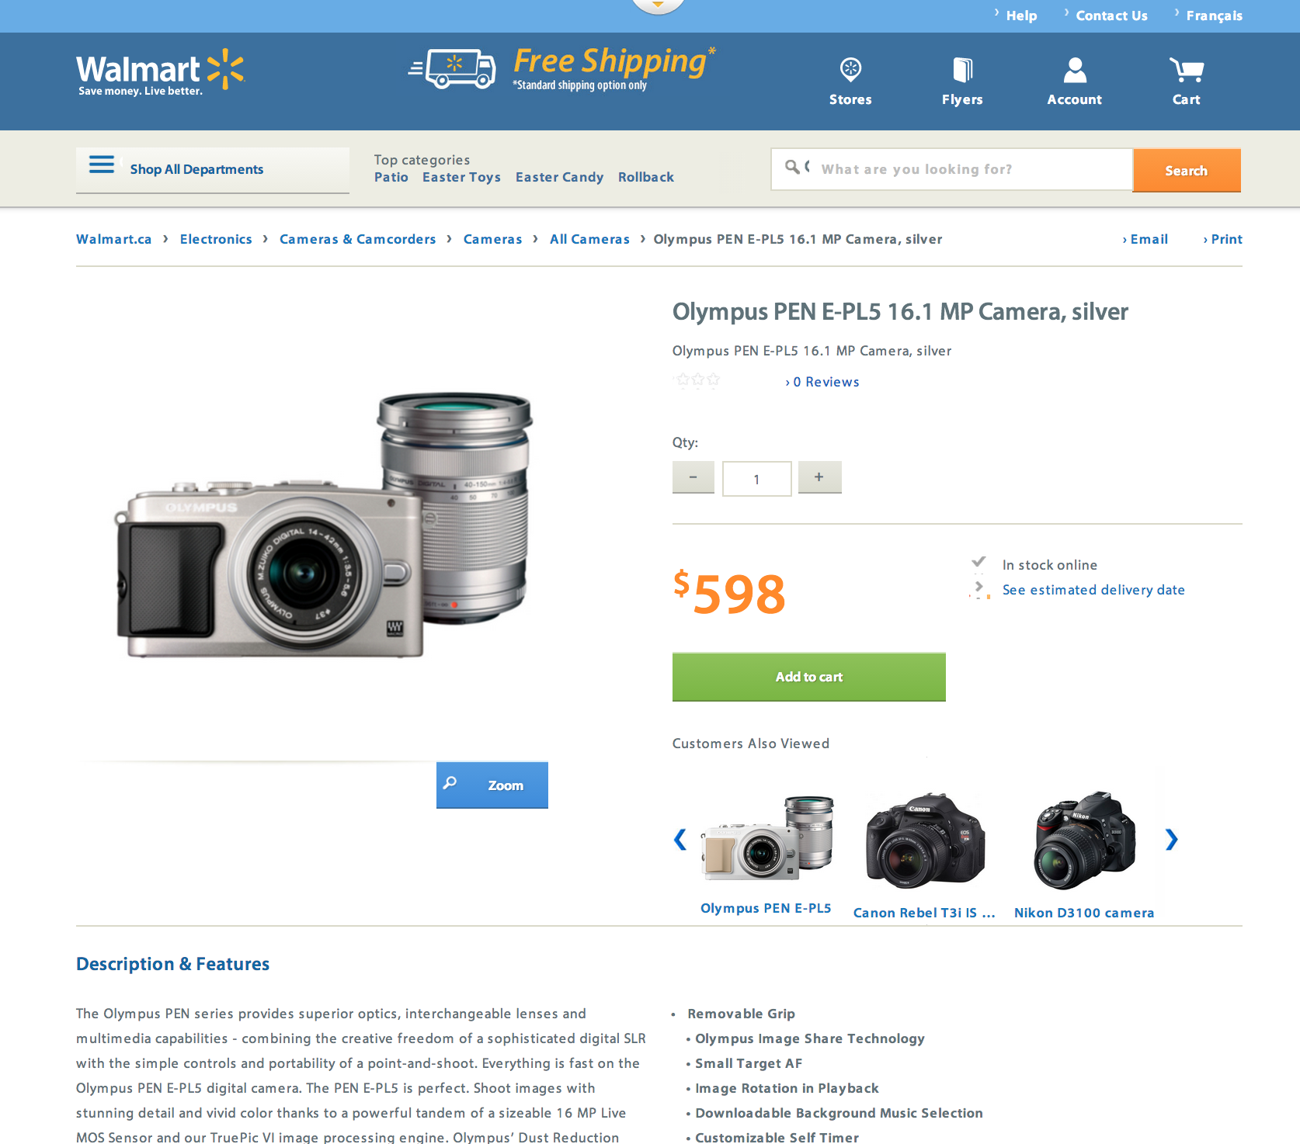

Render JSON
{JSON}
Validation & Caching
Scala Meet-up, April 2014

Slide 5
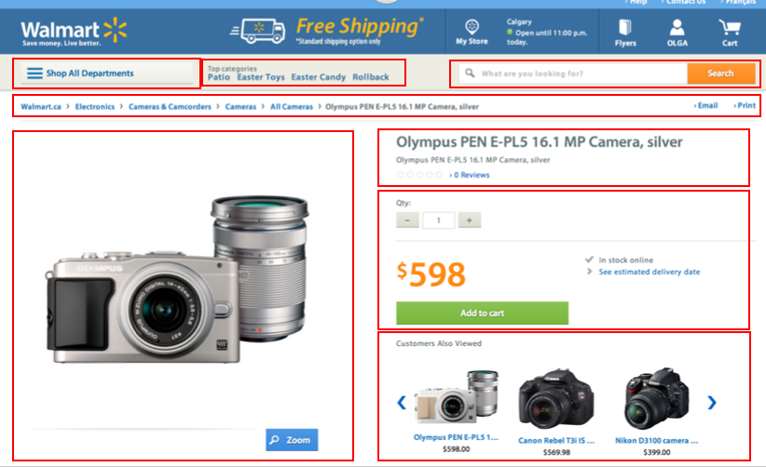

Templates
Validation & Caching
Scala Meet-up, April 2014

Slide 6
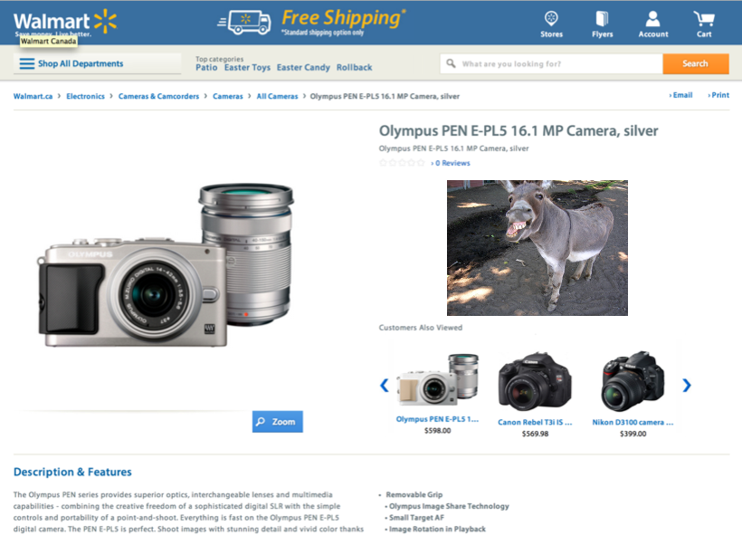
Oops…
Validation & Caching
Scala Meet-up, April 2014

Slide 7
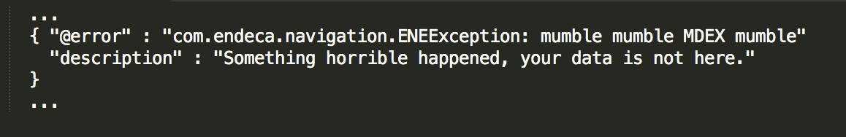
Uh oh…
Validation & Caching
Scala Meet-up, April 2014

Slide 8
And then it gets cached…
Validation & Caching
Scala Meet-up, April 2014

Slide 9
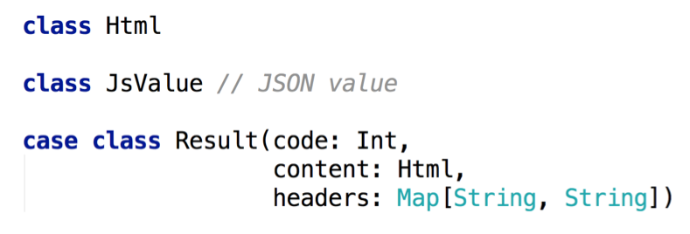
The Basic Types
Validation & Caching
Scala Meet-up, April 2014

Slide 10
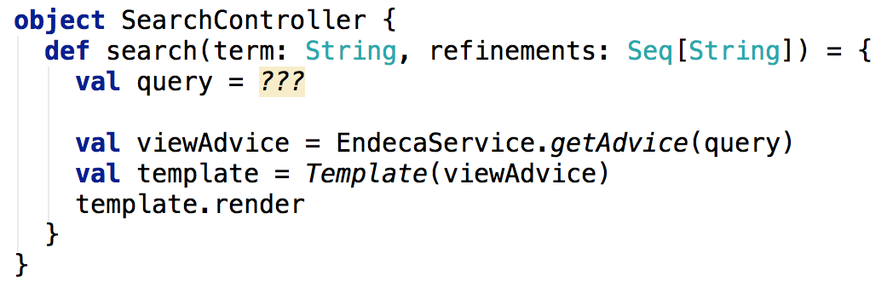
The Controller
Validation & Caching
Scala Meet-up, April 2014

Slide 11
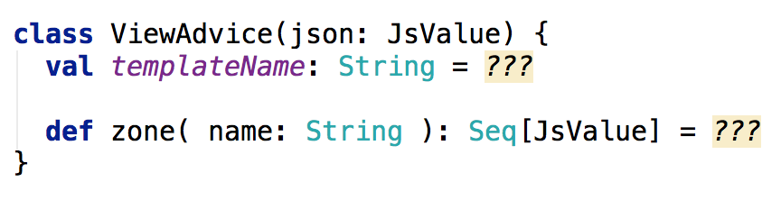
Endeca View Advice
Validation & Caching
Scala Meet-up, April 2014

Slide 12
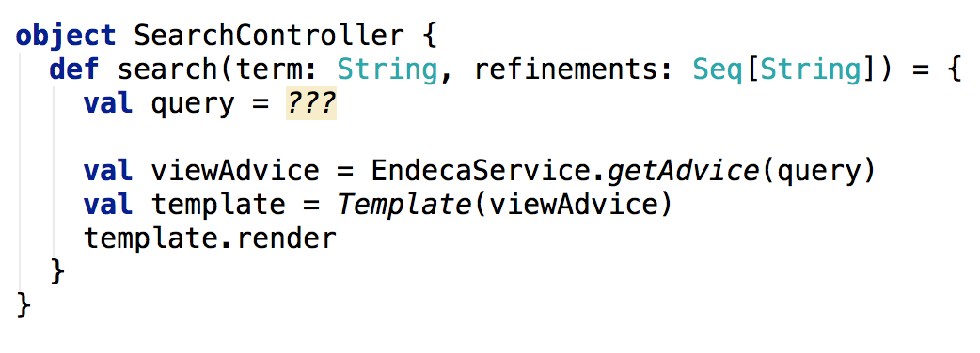
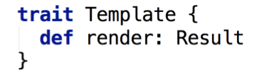
The Controller
7
Validation & Caching
Scala Meet-up, April 2014

Slide 13
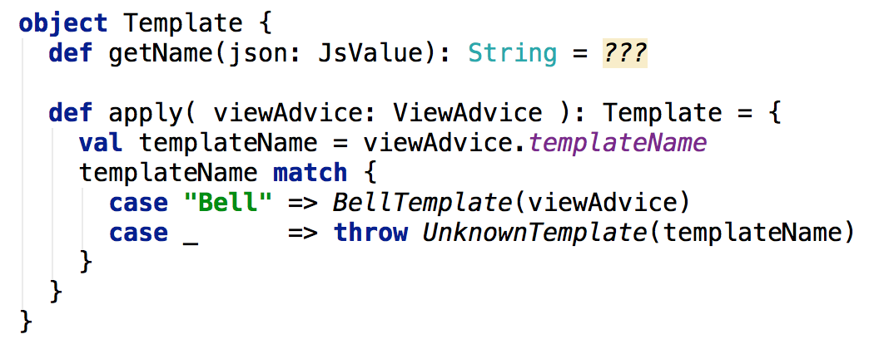
Template Dispatcher
Validation & Caching
Scala Meet-up, April 2014

Slide 14
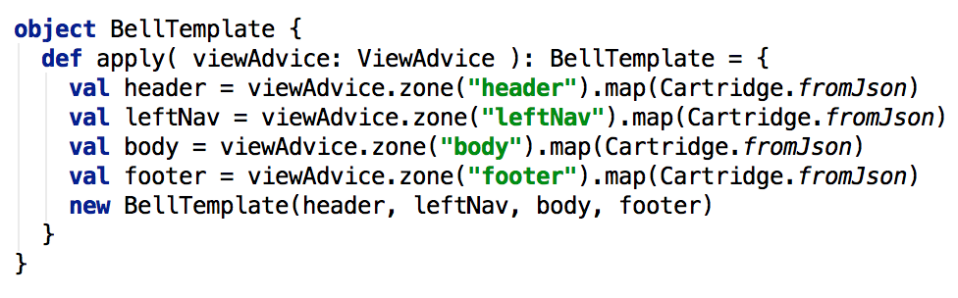
Template Handler
Validation & Caching
Scala Meet-up, April 2014

Slide 15
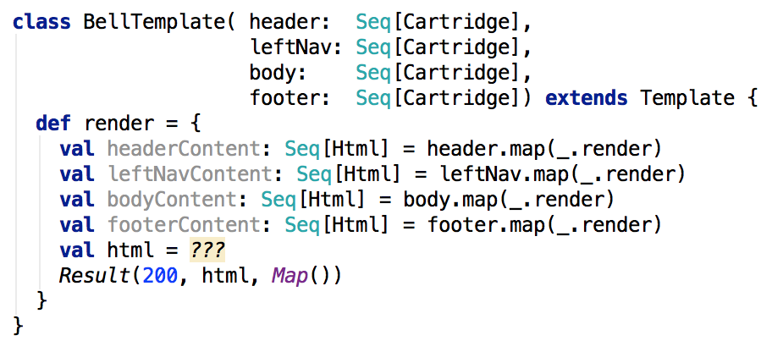
Template Class
Validation & Caching
Scala Meet-up, April 2014

Slide 16
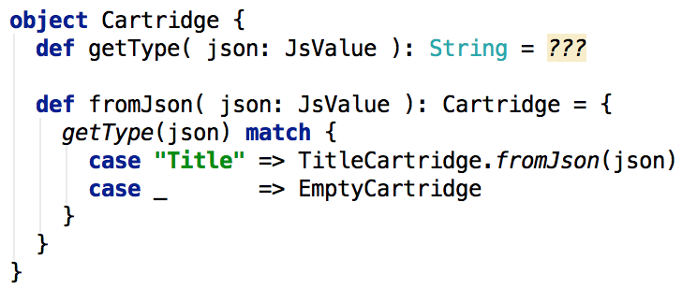
Cartridge Dispatcher
Validation & Caching
Scala Meet-up, April 2014

Slide 17
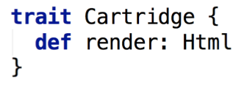
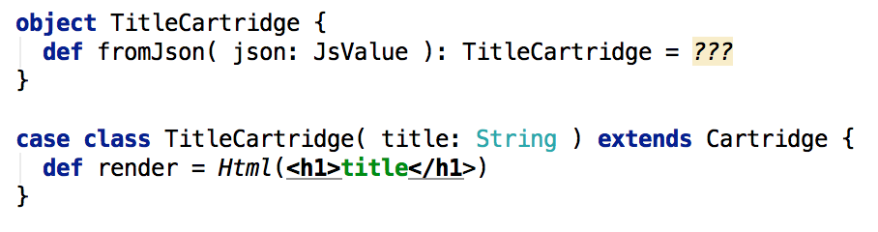
A Cartridge Class
70+
Validation & Caching
Scala Meet-up, April 2014

Slide 18
Dealing with Partial Failures
As we are parsing the cartridges keep track of whether we encounter any issues.
If all is well, hunky dory.
If something is amiss, serve it up, but prevent it from being cached.
Validation & Caching
Scala Meet-up, April 2014

Slide 19
Dreaming…
What special language features would be useful in solving this problem?
What if each cartridge had some meta-data associated to it to signify whether its contents were valid or not.
Ideally this meta-data would just magically get passed along with the cartridge. ‘Bad’ data would infect any results that used it.
Validation & Caching
Scala Meet-up, April 2014

Slide 20
Notions of Computation and Monads (1991)
Moggi: Starting from a very basic programming language many rich features (e.g. partiality, non-determinism, continuations) can be added as monads.
Validation & Caching
Scala Meet-up, April 2014

Slide 21
Notions of Computation and Monads
Possibly undefined data (NULL).
Option
Multi-valued computations (non-determinism, e.g. parsing, queries)
Set (List) [LINQ]
Asynchronous computations.
Future
Validation & Caching
Scala Meet-up, April 2014

Slide 22
Domain Specific Computational Models
A monad consists of a parameterized type, M[_], with:
unit: translates regular value to augmented one.
map: translate an operation on values to one on augmented values
flatMap: translate an augmented operation on a regular value to one that operates on augmented values (variable binding/composition).
Validation & Caching
Scala Meet-up, April 2014

Slide 23
Applying the Validated Notion of Computation
Parsing the ViewAdvice will produce a Template, along with its validity (which we’ll use to determine if we should cache the result.)
The validity is defined at the level of individual cartridges, and propagates up to the zone and template levels.
Validation & Caching
Scala Meet-up, April 2014

Slide 24

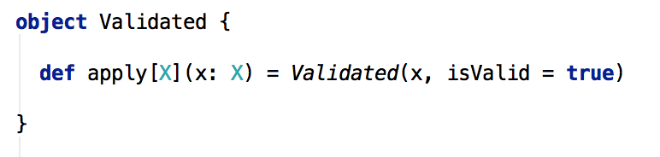
The Validated Class
Validation & Caching
Scala Meet-up, April 2014

Slide 25
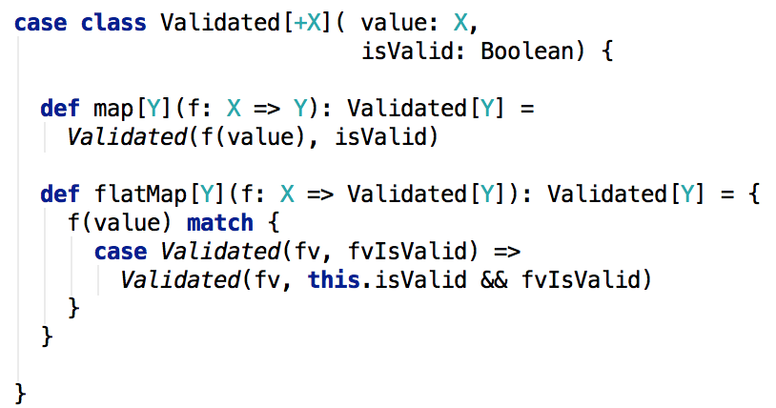
The Validated Class
Validation & Caching
Scala Meet-up, April 2014

Slide 26
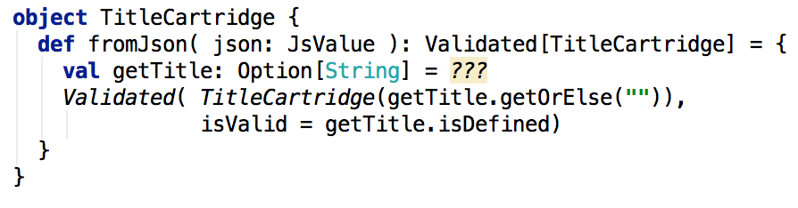
A Validated Cartridge Factory
Validation & Caching
Scala Meet-up, April 2014

Slide 27
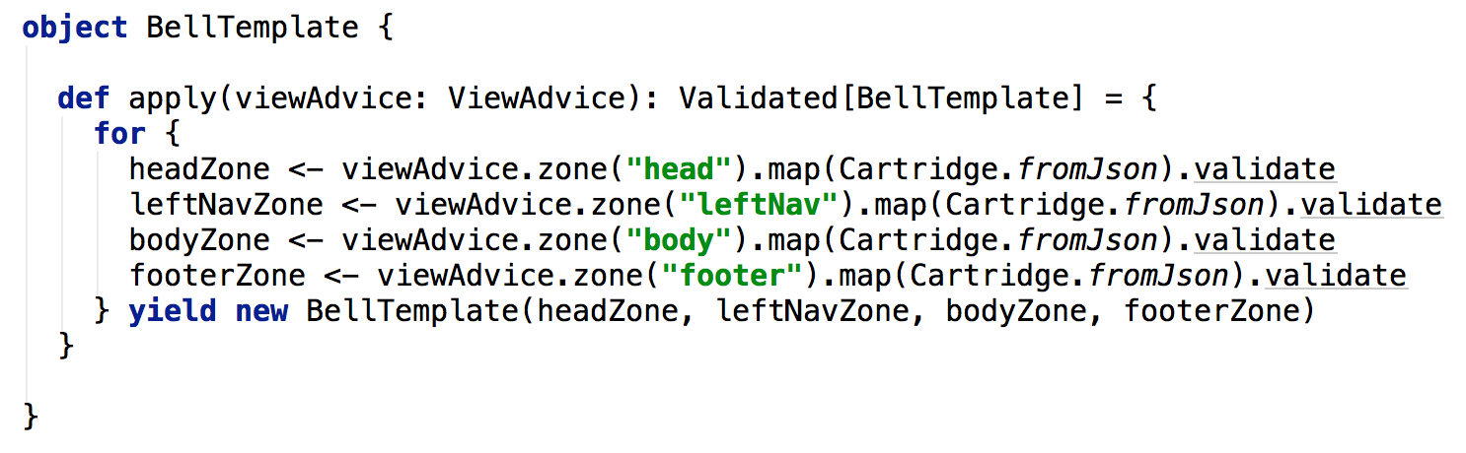
A Validated Cartridge Factory
Validation & Caching
Scala Meet-up, April 2014

Slide 28
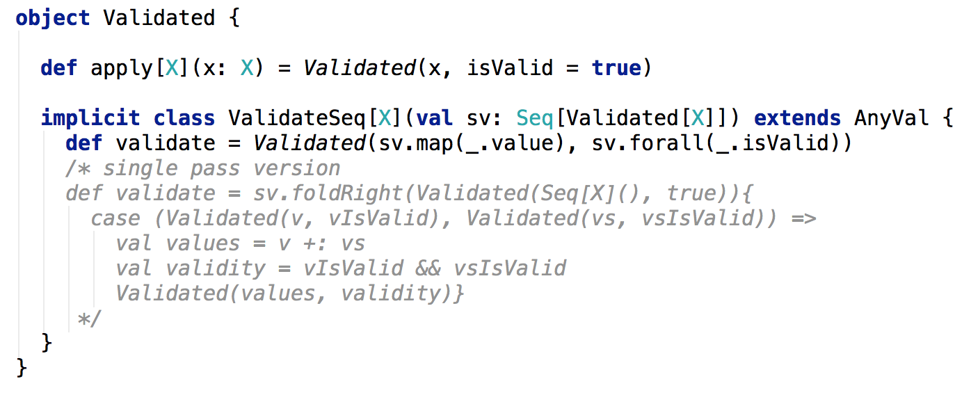
Seq[Validated[X]] => Validated[Seq[X]]
Validation & Caching
Scala Meet-up, April 2014

Slide 29
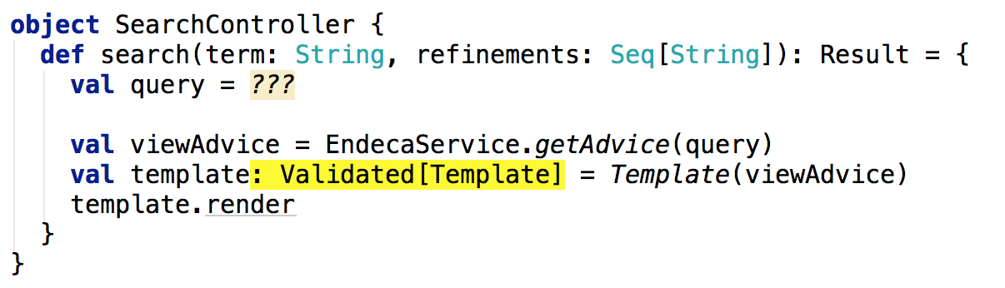
Validated Controller
Validation & Caching
Scala Meet-up, April 2014

Slide 30
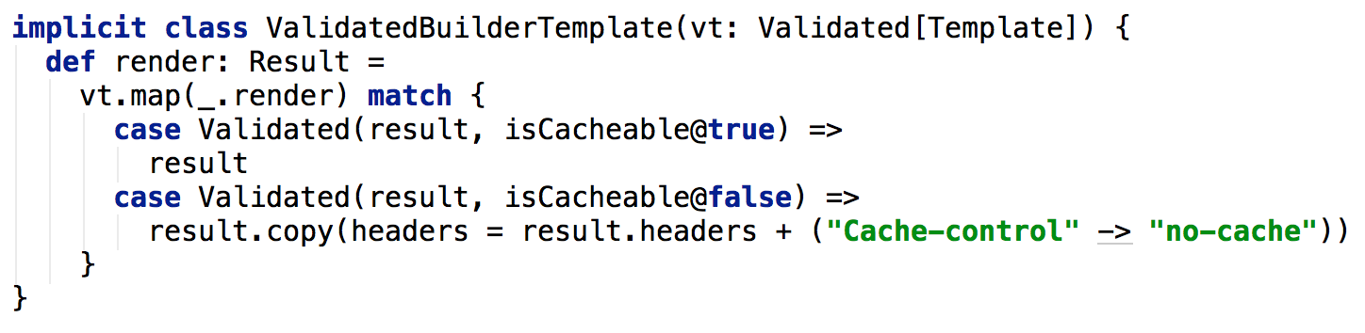
Rendering a Validated[Template]
Validation & Caching
Scala Meet-up, April 2014

Slide 31
Reaping the benefits of a monadic lifestyle
New business requirement:
Some cartridges need to call external services to get data they need to render themselves.
We don’t want to compromise our non-blocking architecture.
Validation & Caching
Scala Meet-up, April 2014

Slide 32
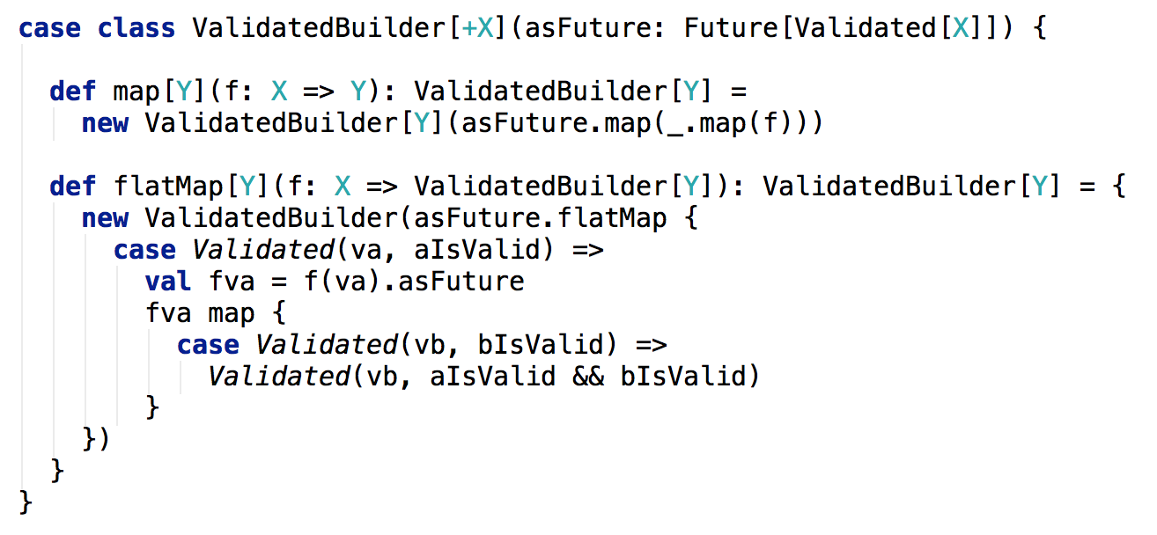
Validated Builder Monad
Validation & Caching
Scala Meet-up, April 2014

Slide 33
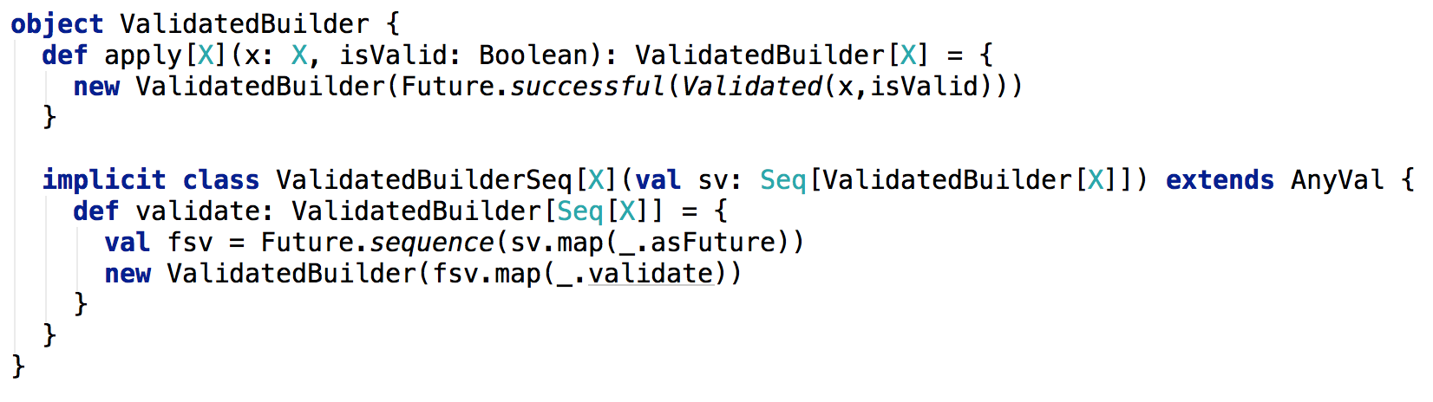
Validated Builder Monad
Validation & Caching
Scala Meet-up, April 2014

Slide 34
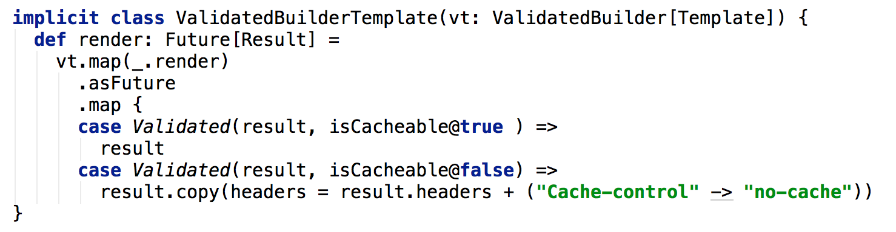
Rendering a ValidatedBuilder[Template]
Validation & Caching
Scala Meet-up, April 2014

Slide 35
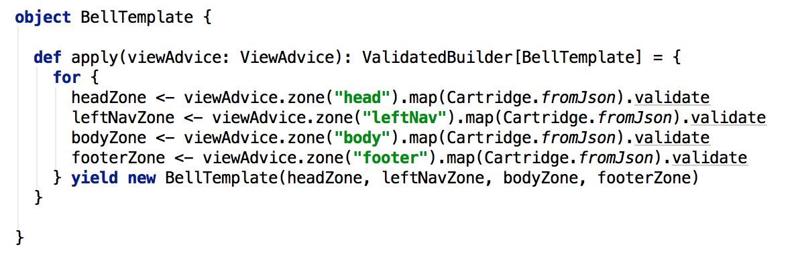
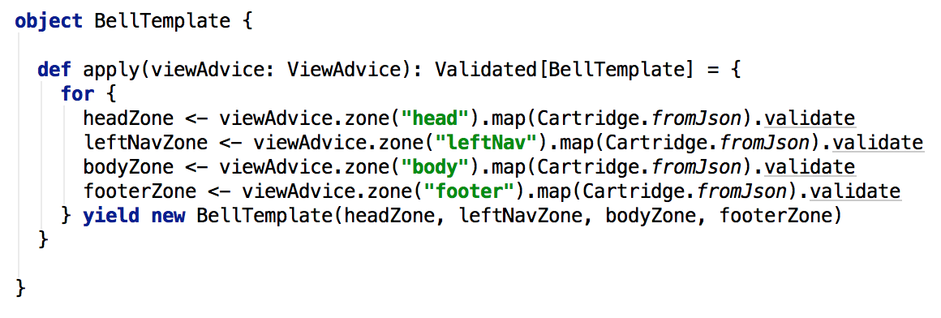
Rendering a ValidatedBuilder[Template]
Validation & Caching
Scala Meet-up, April 2014

Slide 36
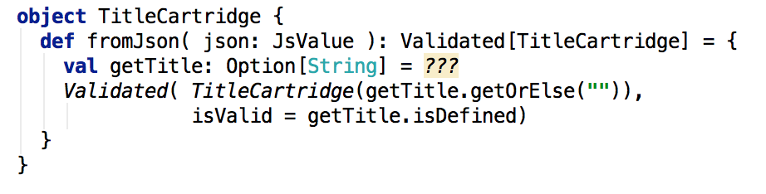
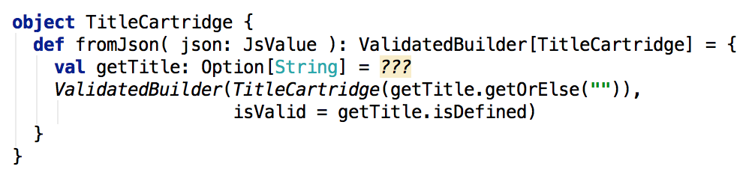
Rendering a ValidatedBuilder[Template]
Validation & Caching
Scala Meet-up, April 2014

Slide 37
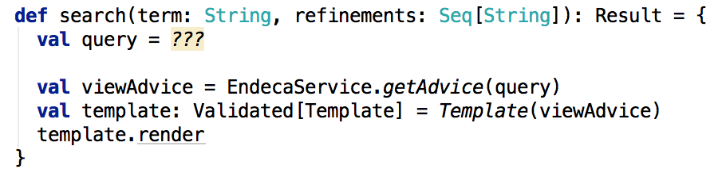
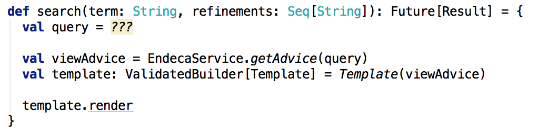
ValidatedBuilder Controller
Validation & Caching
Scala Meet-up, April 2014

Slide 38
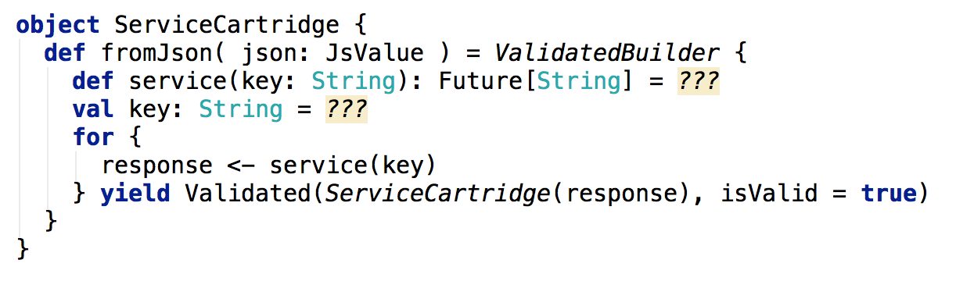
An Asynchronous Cartridge
Validation & Caching
Scala Meet-up, April 2014

Slide 39
What’s next?
Logging (Writer monad)
Context (Reader monad)
Whatever notion of computation suits your needs.
Validation & Caching
Scala Meet-up, April 2014

Slide 40
Factor out composition of computations
Use a monad to handle plumbing concerns.
The implementation of the plumbing can be modified independently.
Validation & Caching
Scala Meet-up, April 2014

Slide 41
Thank You.
Validation & Caching
Scala Meet-up, April 2014

